Slide 1
The American Pageant: England Settles
Chapter Two
Notes and Discussion

Slide 2
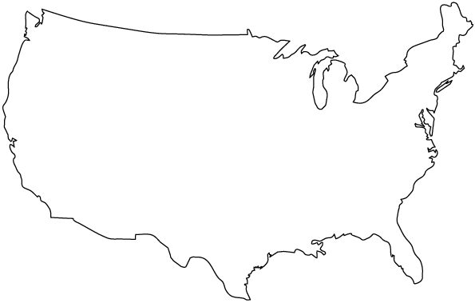
America at European Contact
Impact of Columbian Exchange
Impact of Spanish exploration
Most of the “discoveries” were south of the border
Early seventeenth century—that all changes
French,
Quebec 1608
English,
Jamestown 1607
Spain,
Santa Fe (1610)
Spain

Slide 3
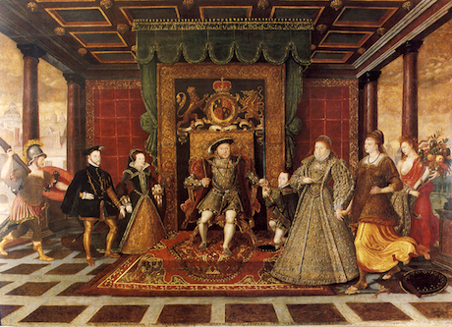
Slow to Explore
England lags behind Spain
Money
Religion
Catholicism and Ireland
Unsuccessful revolts
Irish view of “savage” natives
History repeats itself! What will happen over the next several years?
English Protestant Reformation

Slide 4
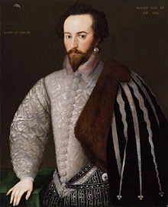
England’s Move to Explore
Three G’s—God, Gold, Glory
England’s two P’s: ______________________, and ___________________
Competition with Spain
Early Attempts
New Foundland (Humphrey Gilbert)
Roanoke Island (Walter Raleigh) –1585
Plunder
Protestantism

Slide 5
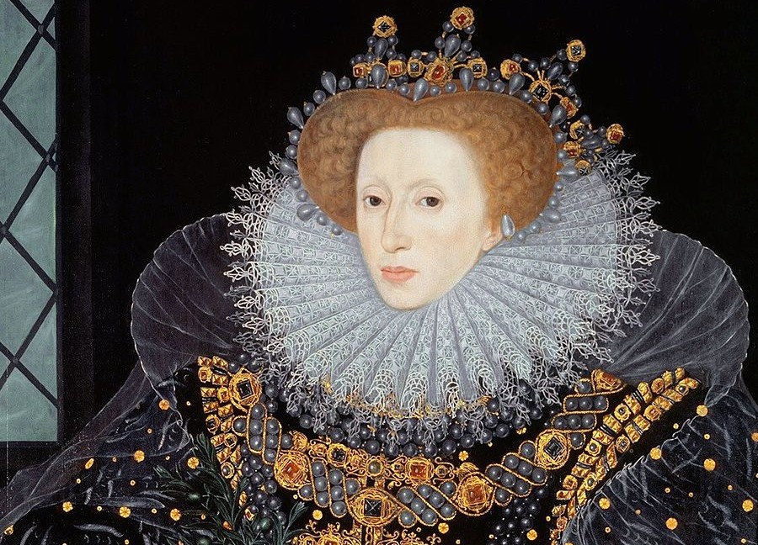
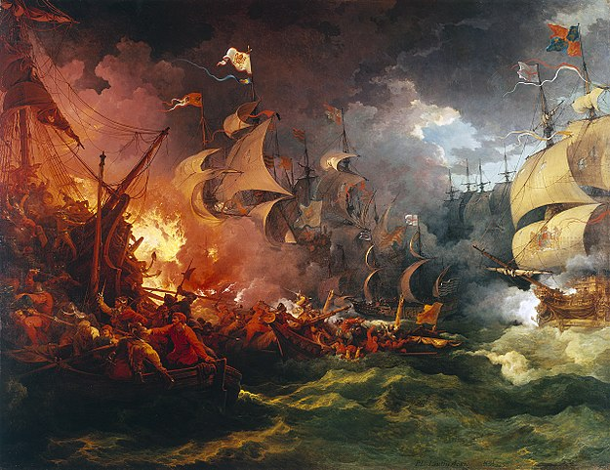
Spanish Armada
Spanish attempt to invade England
1588
England fights back
Weather’s role
Spanish defeat—boosts England’s will to explore!
Boosts England’s nationalism
Beginning of end for Spanish exploration

Slide 6
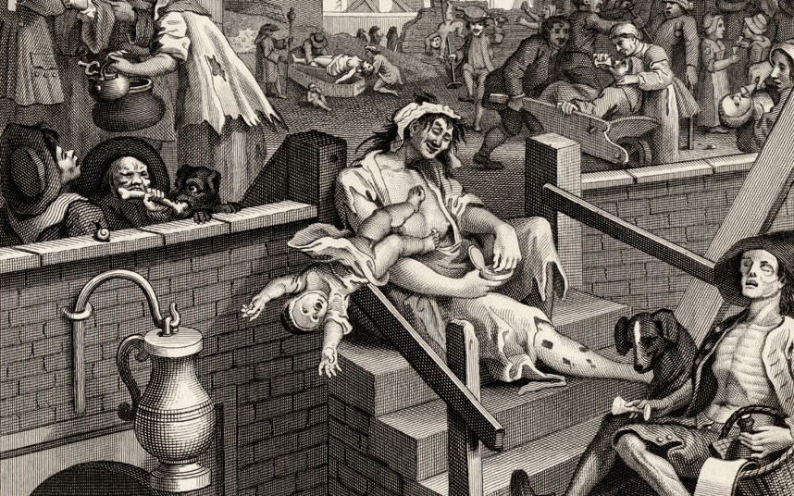
The Eve of Empire
England’s surplus population
3,000,000 → 4,000,000 in 400 years
Fencing and farming
Unemployment
Primogeniture
Favorability with eldest son
Establishment of Joint Stock Companies
Benefits:

Slide 7
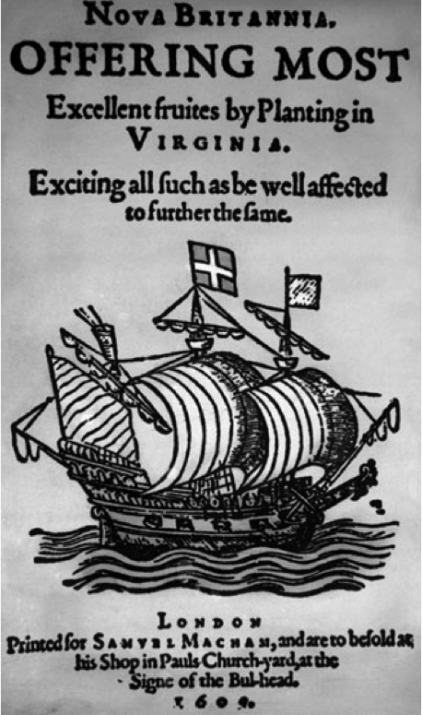
To Explore, England Needs…
Peace with Spain
Extra Workers
G, G, G
Money w/ Joint Stock Companies
OPPORTUNITY

Slide 8
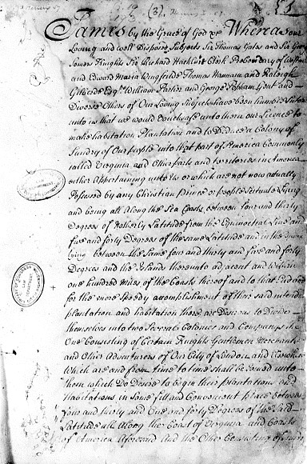
Jamestown
Virginia Company – receives charter from King James I
Settles in the “new world”
Goal –short term!
Sell for a profit!
Why the Charter Matters:
“Rights of Englishmen”
Mainly the right to

Slide 9
Susan Constant, Godspeed, and Discovery Land at Jamestown.

Slide 10
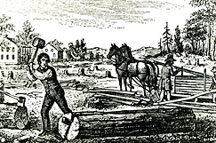
Indentured Servitude
Some come over as free men
Clergy, merchants, artisans, landowners
Most are indentured servants
Surrender freedom for five years
Essentially slaves—even pregnant females
Most die before earning their freedom

Slide 11
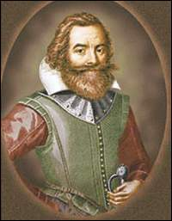
Jamestown almost Doesn’t Make It
“He who shall not work shall not eat”
Mock execution, Pocahontas and Powhatan
Tsenacommacah tribe
Pocahontas serves as an intermediary
Try and maintain peace

Slide 12
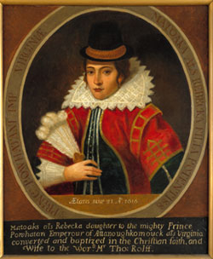
The Disney Version
The Reality

Slide 13
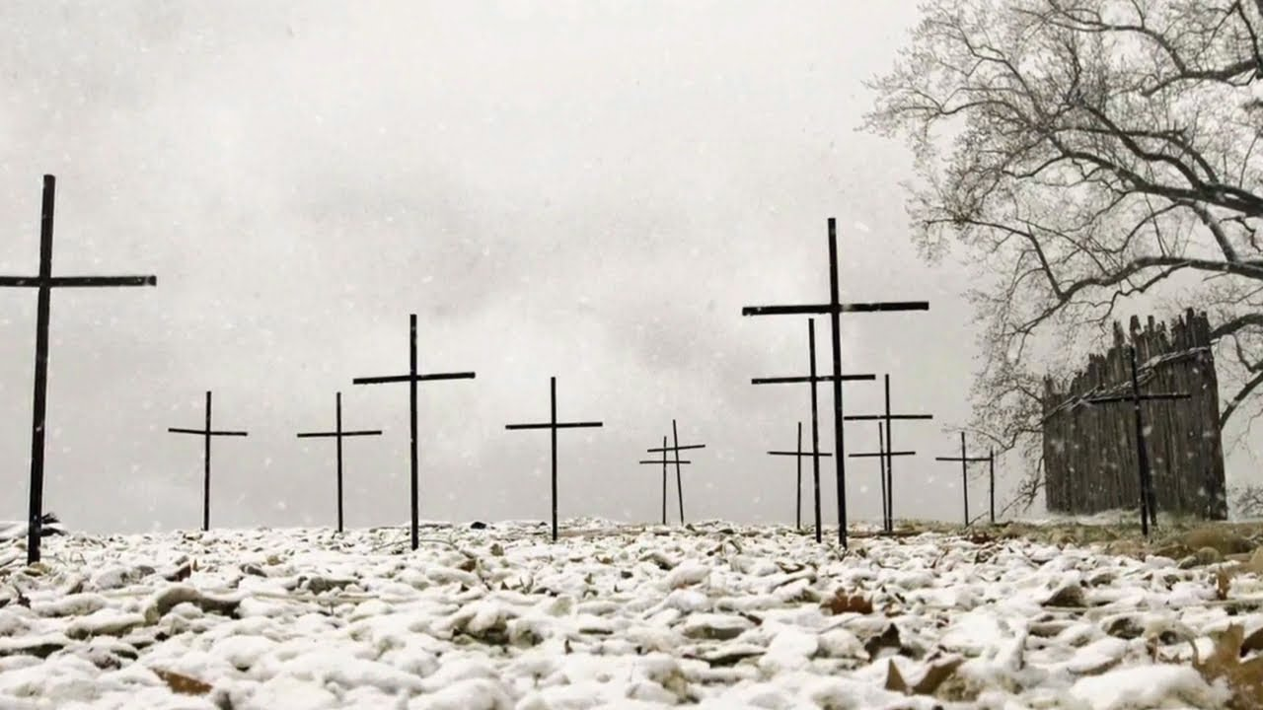
Harsh Reality of Jamestown
No food…still have to eat
8,000 settlers at one point
1,200 survivors by 1625

Slide 14
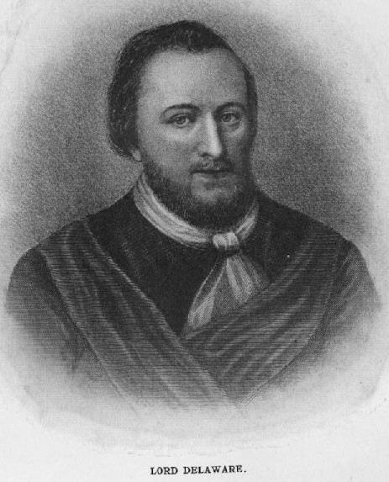
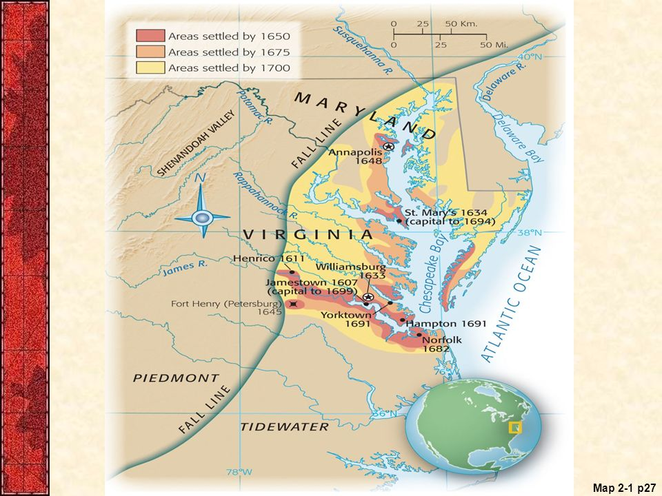
Hope for Reprieve
Surviving colonists try to leave for England
Lord De La Warr stops them, sends them back
Aggressive military leadership
Opens up warfare against Indians

Slide 15
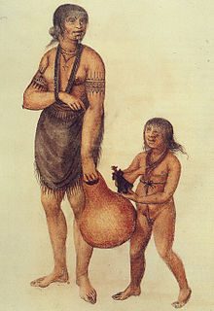
Tense Relations with natives
First and Second Anglo-Powhatan Wars
1614, 1644
“Peace”
Marriage of Rolfe and Pocahontas
Weaponry, diseases, attacks, etc.
De La War attempts to establish dominance
Natives don’t use land, we do
Displace—beginnings of reservation system
Very little inter-relations with natives
Natives are “disposable” and not reliable

Slide 16
Impact on Natives
Proximity matters!
The closer to England, the more controlled.
The farther from England, the more “freedom” they had!
Demographic, Cultural; Cultural Diffusion
Re-invent self; way of life
Horses Stolen
Scrambled together; Separated apart
From forest dwellers to nomads
Trade—especially firearms
Indian-on-Indian violence
Some cases of Indians outnumbering; over powering Europeans—Europeans assimilate!
Disease
Stories literally die out
Slavery

Slide 17
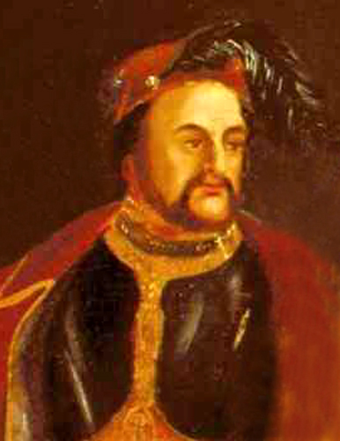
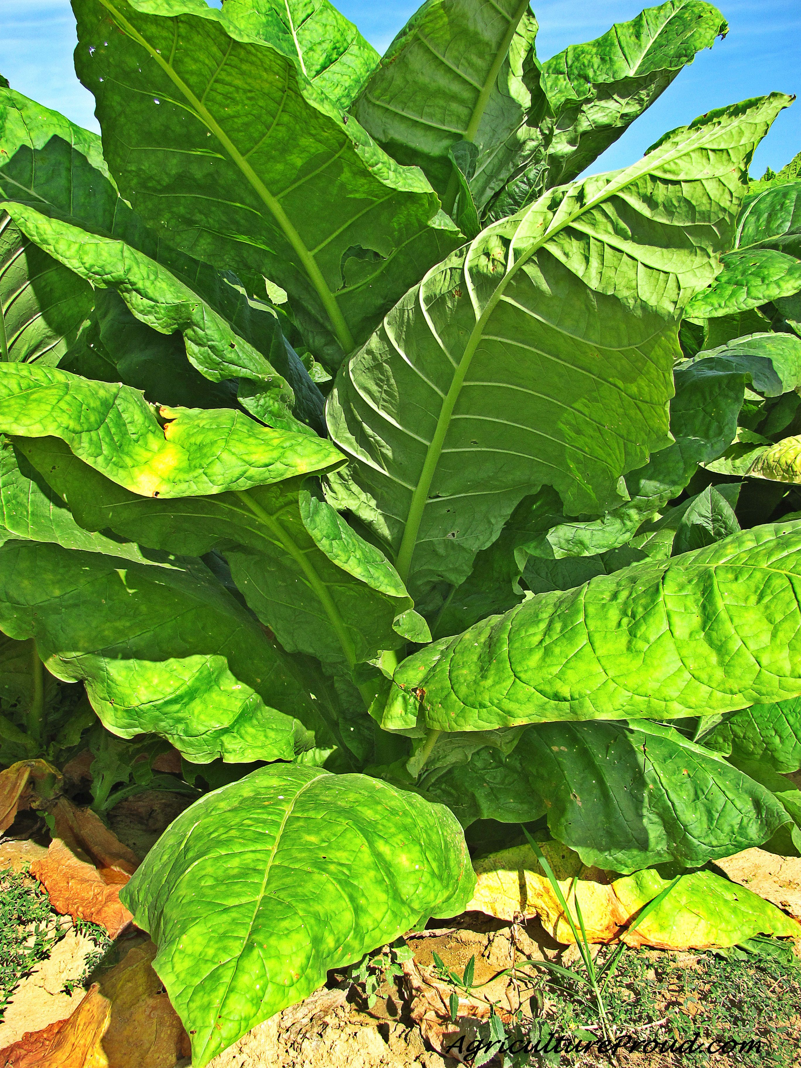
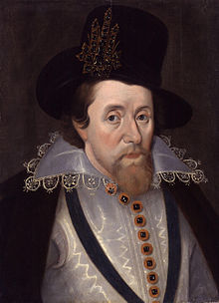
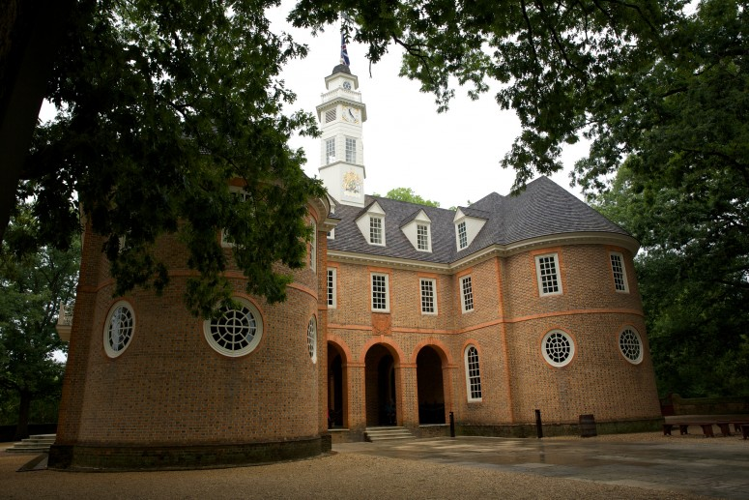
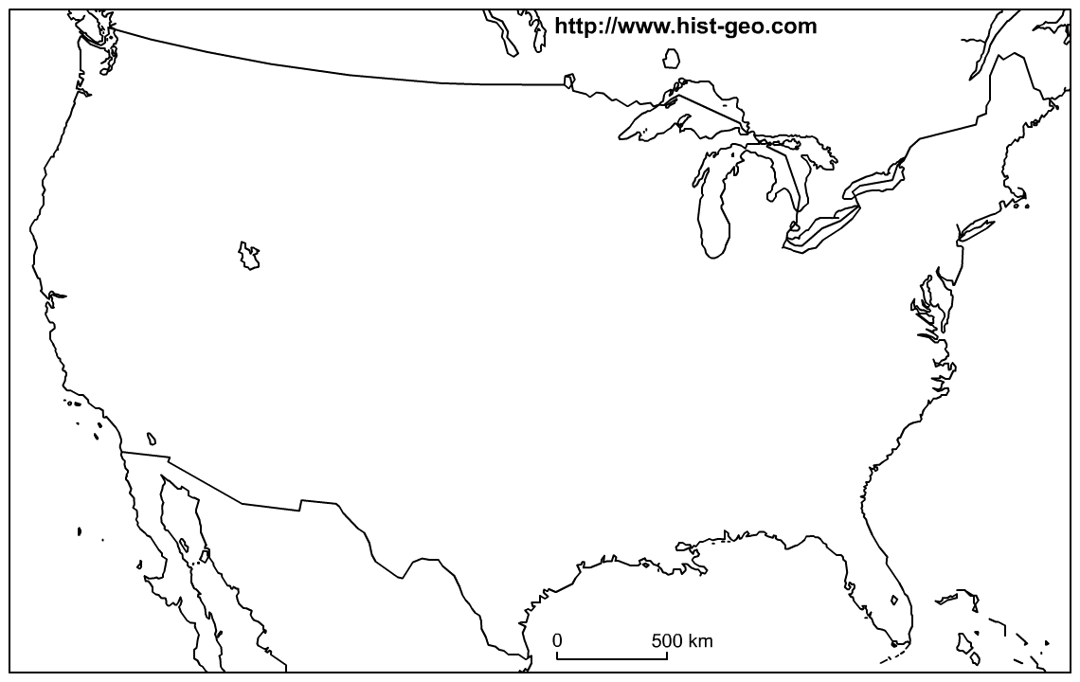
John Rolfe, 1612
Virginia
Tobacco
-Virginia’s new obsession
-Fight for food → Fight for land
Economic Powerhouse “King Nicotine”
CONS-
-Importation of slaves
-Depletes land
House of Burgesses (1619)
First Assembly of settlers
-James I revokes charter; VA is a royal colony (1624)

Slide 18
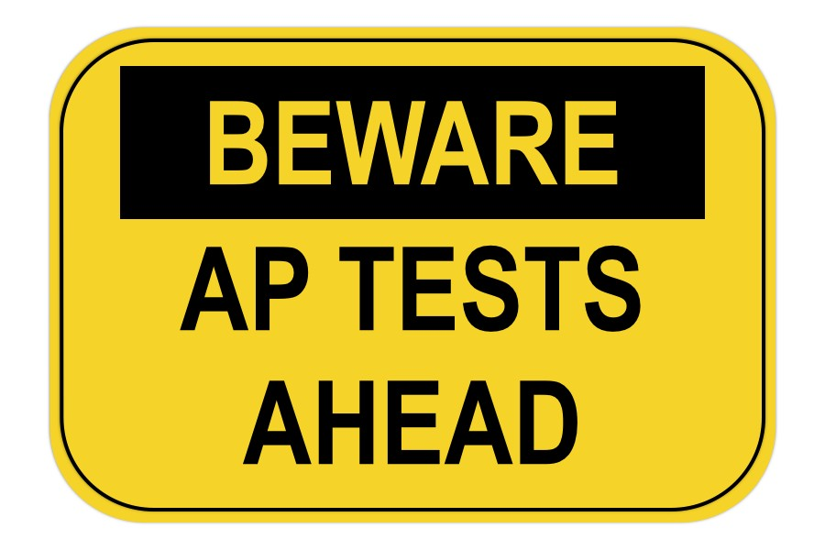
You’re Through Jamestown!
Test—August 30
We will resume colonization, the American Revolution and life in between afterwards!

